Slide 1
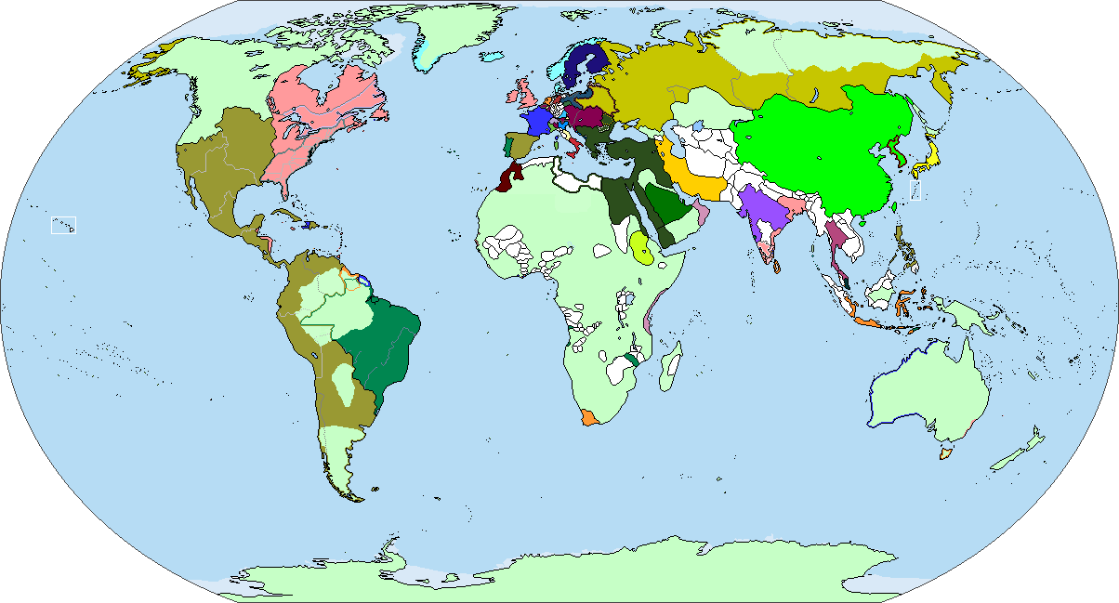
The World in 1763

Slide 2
Revolution in Politics
The last half of the 18th century was a period of political upheaval
Revolutions challenged the old order of monarchs and aristocrats
New concepts of freedom and equality spread across Europe and the Americas
These ideas were the catalyst for the revolutionary period in North America, France, Haiti and Latin America

Slide 3
Revolution in America
The Treaty of Paris in 1763 left Great Britain as the world’s greatest colonial power
Britain increased tariffs and taxes on the colonists to pay for their protection during the Seven Years’ War
The Stamp Act of 1765 required a government stamp on all documents and legal papers
The Townsend Acts of 1767 levied taxes on lead, paint and glass and increased tariffs
Both Acts were repealed in 1770 due to colonial protest to the new taxes and tariffs

Slide 4
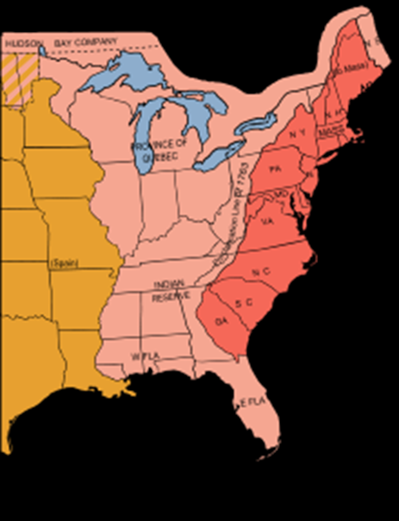
The American Revolution
In 1773, the dispute over taxes and the lack of representation re-appeared
East India Company gained a monopoly on the tea trade to the colonies, selling directly to their agents

Slide 5
Road to Revolution
On December 16, 1773, East Indian tea was dumped into Boston Harbor
The Coercive Acts passed by Parliament in March 1774 closed the port of Boston, required a royal appointment for a government position, and allowed for the quartering of British soldiers in private homes
In September 1774, representatives from the colonies met in Philadelphia as the 1st Continental Congress

Slide 6
A New Nation is Born
Signed on September 3, 1783, the Treaty of Paris acknowledge the independence of the (13) American colonies and established its boundaries
In 1783 the Congress of the Confederation began working on the Articles of Confederation
On September 17, 1787, in New York City Congress passed a new Constitution of the United States
The Bill of Rights adopted in March 1789, established basic freedoms, including religion, speech, the press along with trial by jury

Slide 7
Reaction to the American Revolution
Many Europeans viewed the revolution as the beginning of a new era of international political change
Many Europeans were now convinced the political ideas of the Enlightenment were valid
European books, newspaper articles, and pamphlets provided accounts of the Revolution

Slide 8
France and the American Revolution
Many French soldiers returned from the Revolution inspired by the ideas of individual liberties, republicanism, and popular sovereignty
The French Revolution was more complex, violent, and radical
The French Revolution set an example for revolutions in other states around the world

Slide 9
The Three Estates
The 1st Estate was made up of nearly 130,000 members of the clergy with certain privileges and rights
The 2nd Estate was made up of nearly 350,000 members of the nobility with hereditary titles
The 3rd Estate was made up of everyone else, about 75-80%, the majority of the population of France

Slide 10
Road to Revolution
An economic crisis and poor harvest in 1787 and 1788 resulted in food shortages and rising prices
By 1788, half of the French treasury goes to pay the interest on the country’s war debt
By July 1789, half of the income of the poor was spent on bread, a basic of daily diet
Economic depression spread across France

Slide 11
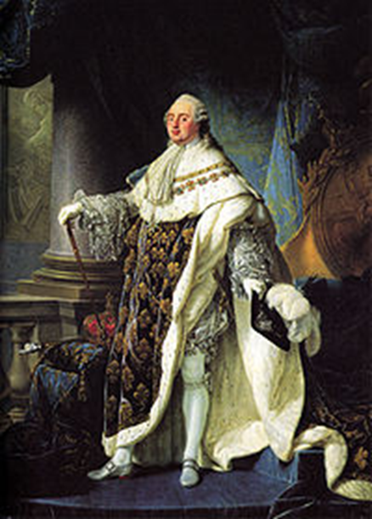
The Revolution
The National Assembly abolished the French nobility
In July 1790, Louis accepted a new constitution which limited his royal powers
Nationalized properties of the church and abolished monasteries

Slide 12
A New Direction
On August 10, 1792, Paris mobs took the royal family hostage and forced the Assembly to suspend the monarchy
The Paris Commune assumed control of the security of Paris
In September 1792, thousands of suspected “traitors to the state” were imprisoned and later killed in the “September Massacres”
On September 21, the newly elected National Convention abolished the monarchy and proclaimed France a republic

Slide 13

Committee of Public Safety
Established in April 1793 to administer the government
Headed by Robespierre
Established revolutionary courts to protect the revolution from internal enemies
These courts began a “Reign of Terror” that claimed over (40,000) French lives, including Queen Marie Antoinette

